Slide 1
Agenda
Process Concept
Process Control Block
Two State Model
Five State Model
Extended Five State Model
Process Image
Context Switching
Process Scheduling

Slide 2
Process Concept
An operating system executes a variety of programs:
Batch system – jobs
Time-shared systems – user programs or tasks
Textbook uses the terms job and process almost interchangeably.
Process – a program in execution; process execution must progress in sequential fashion.
A process includes:
program counter
stack
data section

Slide 3
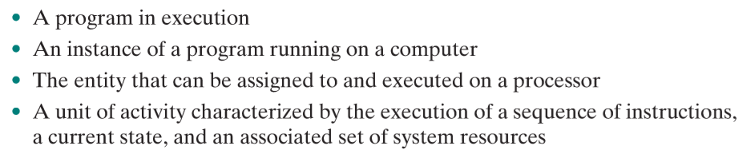
Process Concept

Slide 4
Process Control Block (PCB)
Information associated with each process.
Process state
Program counter
CPU registers
CPU scheduling information
Memory-management information
Accounting information
I/O status information

Slide 5
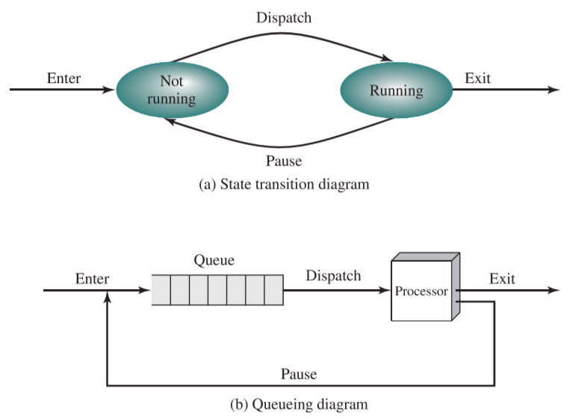
Two State Model
Dispatcher or Scheduler

Slide 6
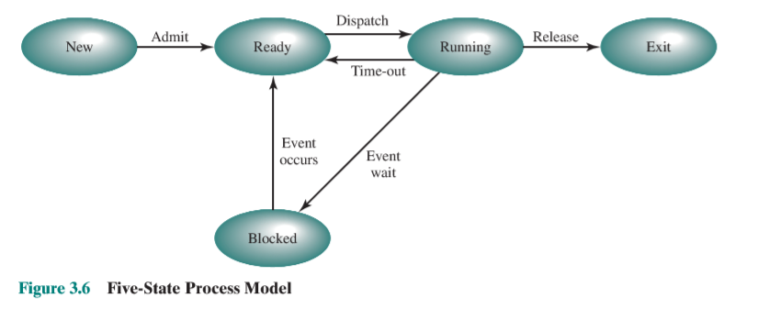
Five State Model

Slide 7
Process State
As a process executes, it changes state
new: The process is being created.
running: Instructions are being executed.
waiting: The process is waiting for some event to occur.
ready: The process is waiting to be assigned to a process.
terminated: The process has finished execution.

Slide 8
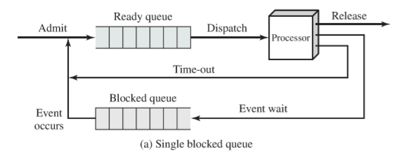
Five State Model - Implementation

Slide 9
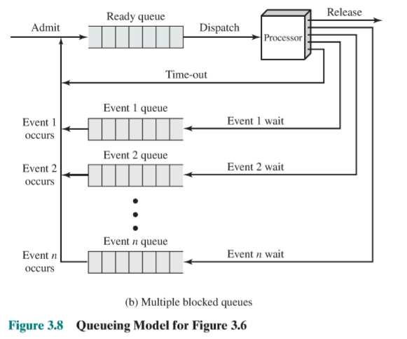
Five State Model - Implementation

Slide 10
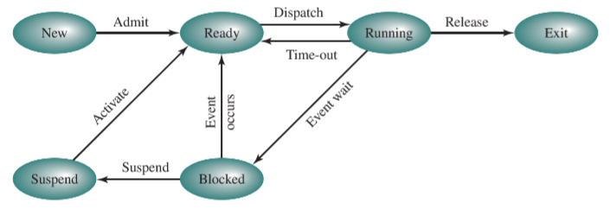
Extended Five State Model

Slide 11
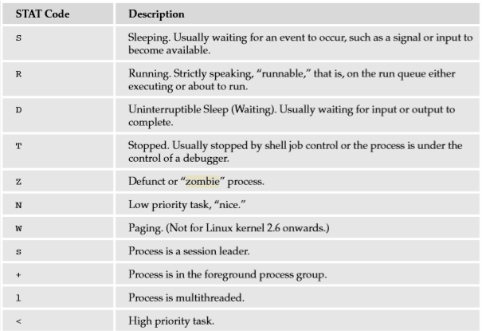
UNIX Process States

Slide 12
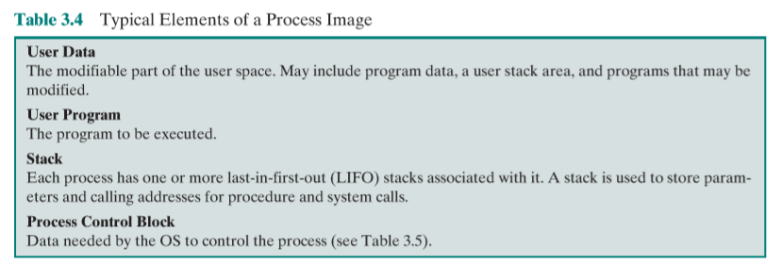
Process Image

Slide 13
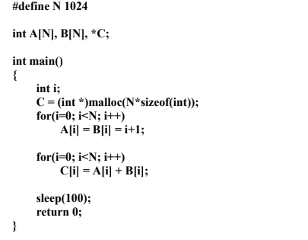
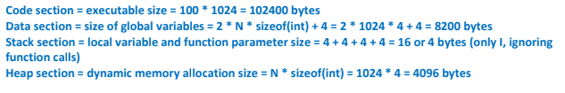
Process Image - Calculation

Slide 14
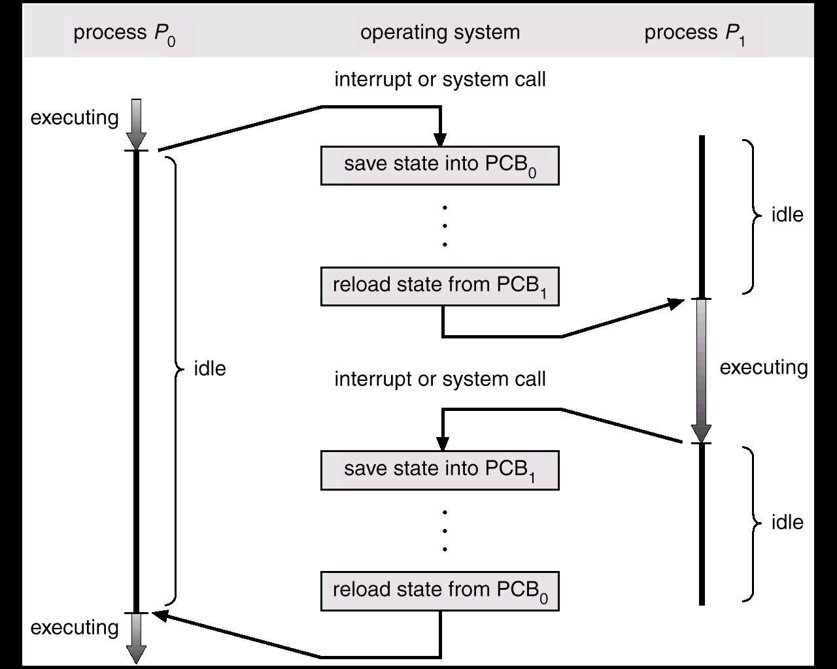
CPU Switch From Process to Process

Slide 15
Context Switch
When CPU switches to another process, the system must save the state of the old process and load the saved state for the new process.
Context-switch time is overhead; the system does no useful work while switching.
Time dependent on hardware support.

Slide 16
Process Scheduling Queues
Job queue – set of all processes in the system.
Ready queue – set of all processes residing in main memory, ready and waiting to execute.
Device queues – set of processes waiting for an I/O device.
Process migration between the various queues.

Slide 17
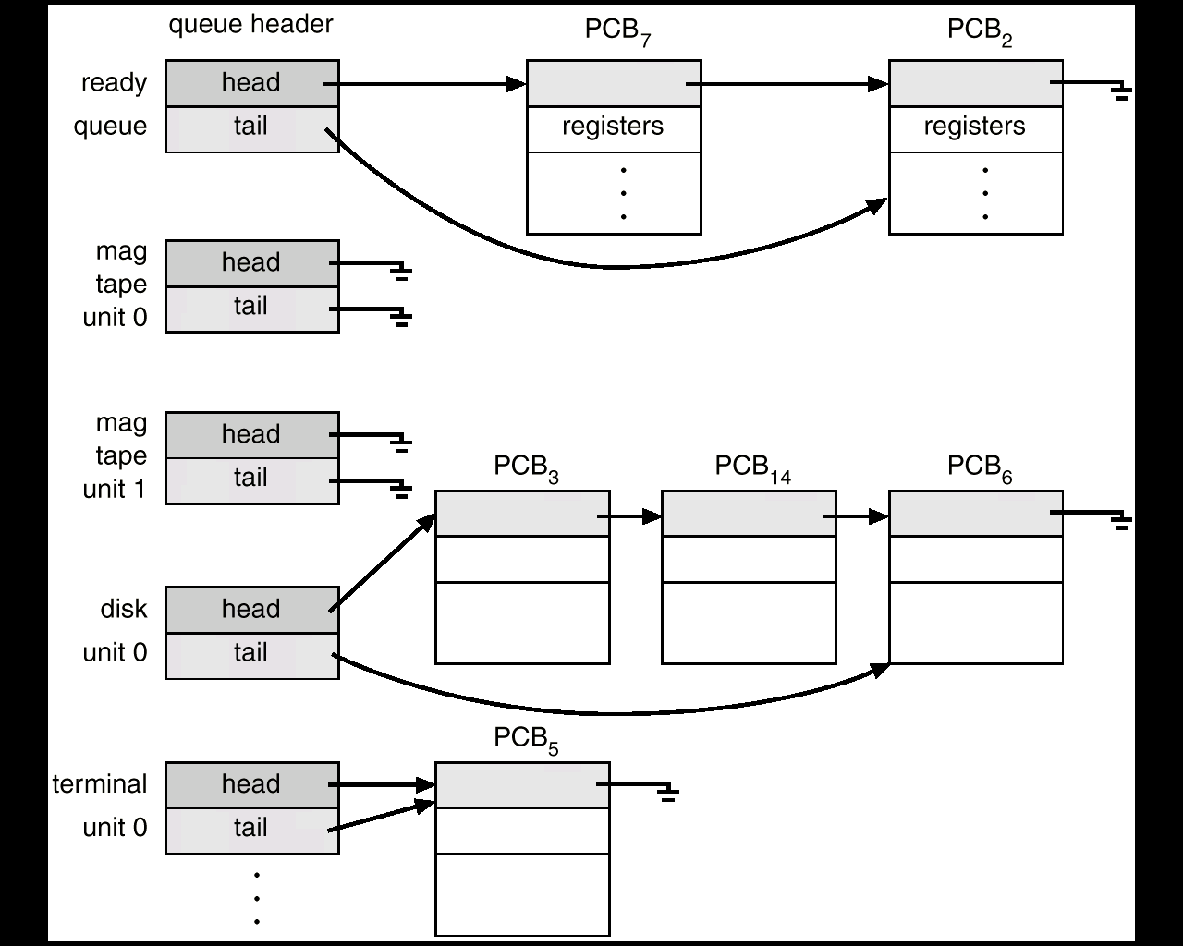
Ready Queue And Various I/O Device Queues

Slide 18
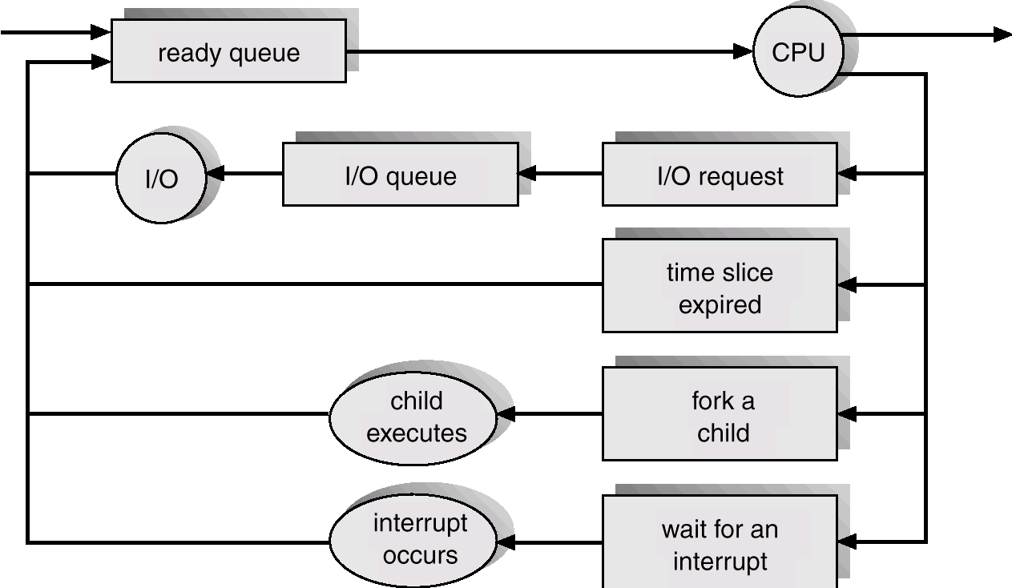
Representation of Process Scheduling

Slide 19
Schedulers
Long-term scheduler (or job scheduler) – selects which processes should be brought into the ready queue.
Short-term scheduler (or CPU scheduler) – selects which process should be executed next and allocates CPU.

Slide 20
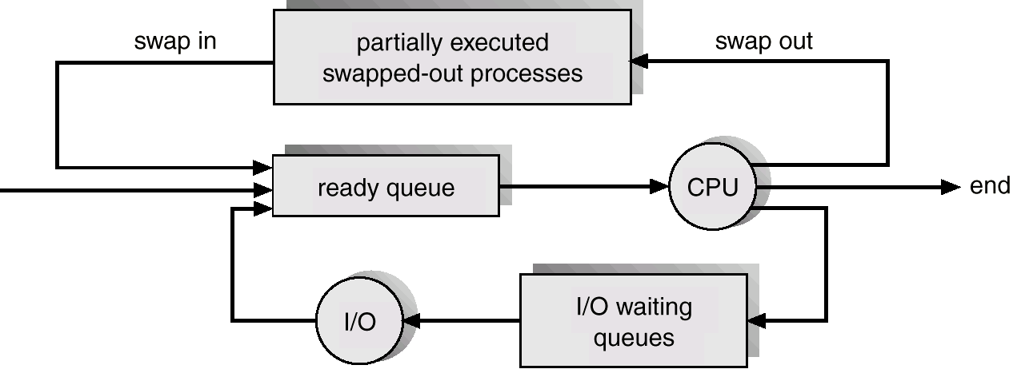
Addition of Medium Term Scheduling

Slide 21
Schedulers (Cont.)
Short-term scheduler is invoked very frequently (milliseconds) ⇒ (must be fast).
Long-term scheduler is invoked very infrequently (seconds, minutes) ⇒ (may be slow).
The long-term scheduler controls the degree of multiprogramming.
Processes can be described as either:
I/O-bound process – spends more time doing I/O than computations, many short CPU bursts.
CPU-bound process – spends more time doing computations; few very long CPU bursts.

